Slide 1
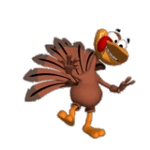
“Trabajo semanal 23-27 Noviembre.”
Lo veremos en tutoría
6th Grade
Recuerden que no es necesario imprimir esta presentación

Slide 2
Pages
Página 80 ejercicio 12 une las imagines con las oraciones
Página 81 ejercicio 14 lee y comprende el texto ( fabula)
Página 81 ejercicio 15 responde las 4 preguntas sobre el texto ( en inglés y oraciones completas)
Página 81 ejercicio 16 destaca en el texto los adverbios de modo que pueda identificar ( ver language noticeboard de la semana pasada?

Slide 3
Página 80 ejercicio 12 une las imagines con las oraciones

Slide 4
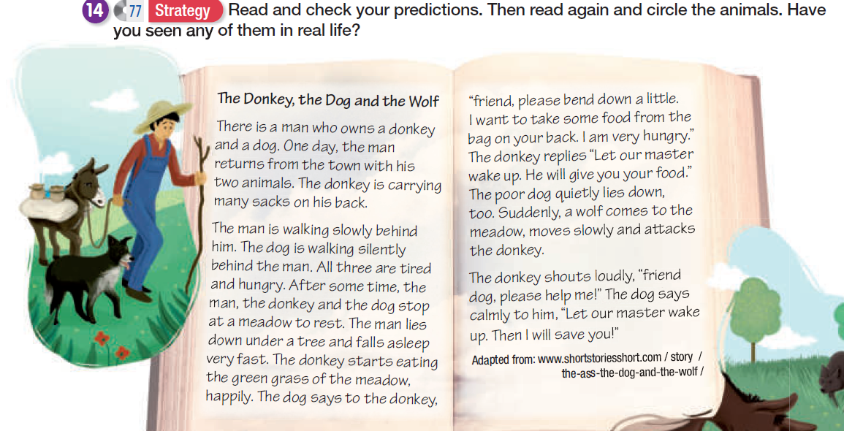
Página 81 ejercicio 14 lee y comprende el texto ( fabula)

Slide 5
Página 81 ejercicio 15 responde las 4 preguntas sobre el texto ( en inglés y oraciones completas)
a. What happens in the end of the story? Would you prefer a different ending? Which one?
b. Describe your favorite character in the story. Why did you like it?
c. What’s the moral of the story? What can you learn from the story?
d. “What you do, comes back to you”. Do you agree with this saying? Discuss.

Slide 6
Página 81 ejercicio 16 destaca en el texto los adverbios de modo que pueda identificar ( ver language noticeboard de la semana pasada?
There is a man who owns a donkey and a dog. One day, the man returns from the town with his two animals. The donkey is carrying many sacks on his back.
The man is walking slowly behind him. The dog is walking silently behind the man. All three are tired and hungry. After some time, the man, the donkey and the dog stop at a meadow to rest. The man lies down under a tree and falls asleep
very fast. The donkey starts eating the green grass of the meadow happily. The dog says to the donkey , “friend, please bend down a little.
I want to take some food from the bag on your back. I am very hungry.” The donkey replies “Let our master wake up. He will give you your food.”
too. Suddenly, a wolf comes to the meadow, moves slowly and attacks the donkey.
The donkey shouts loudly, “friend dog, please help me!” The dog says calmly to him, “Let our master wake up. Then I will save you!”

Slide 7
Recuerda solo enviar tus guías de síntesis
Mariajose.araya@colegiomariagriseldavalle.cl

Slide 8
Happy Thanksgiving

