Slide 1
4to Medio
Semana 28-02 de septiembre

Slide 2
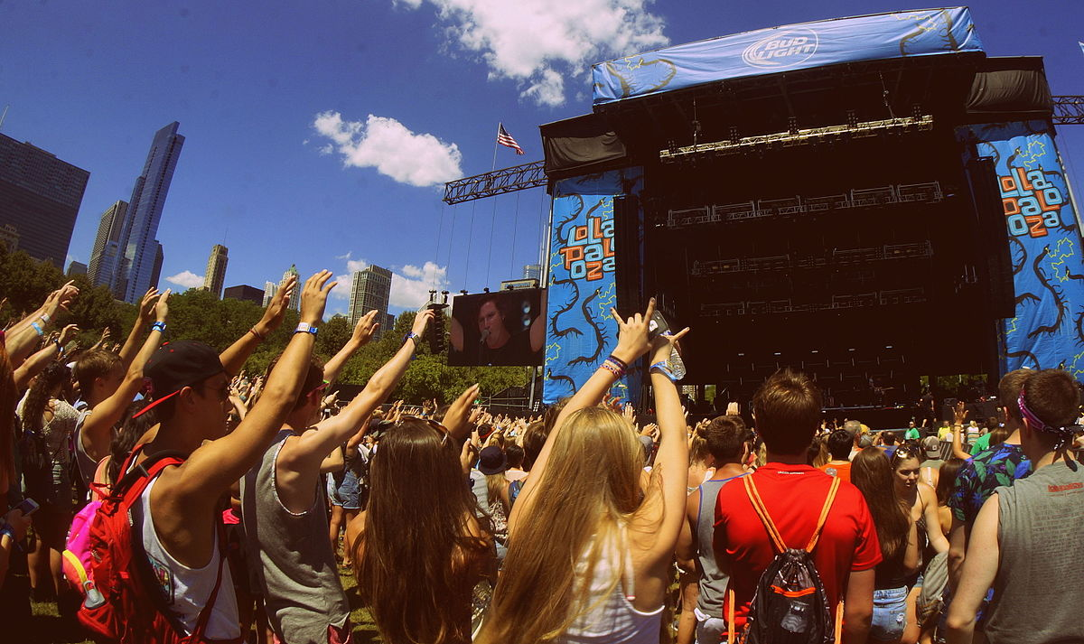
Match the music festival to the type of music
PAG 31
Une el festival con el tipo de música
Lollapalooza
latin American
Creamfields
electronic
Primavera Fauna
indie
Crush Power Music
pop

Slide 3
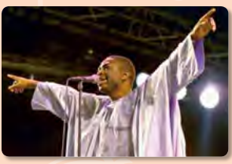
Answer the following questions
PAG 31
Contesta las siguientes preguntas
a Look at the photos. What can you see?
b Look at the title. Is WOMAD a real word
or an invented one? What do you think it
stands for?
c What do you predict the text is about?

Slide 4
Read the following text
Lee el siguiente texto

Slide 5
Read the following text
Lee el siguiente texto

Slide 6
Answer questions
Contesta preguntas
a What’s the aim of WOMAD?
b What can you do at WOMAD apart from
listening to music?
c Why is WOMAD important for Cáceres?

