Slide 1
4to Medio
Semana 17 Agosto

Slide 2
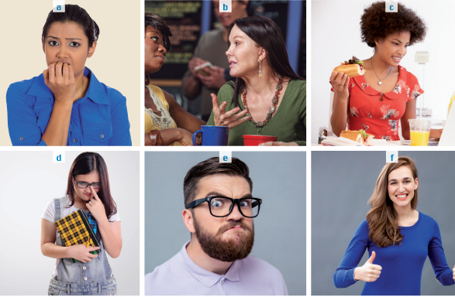
Match the words with the pictures
PAG 126
Une las palabras con las imágenes
Optimistic
Insecure
Shy
Hard-working
Talkative
Bad-tempered

Slide 3
Writing sentences
PAG 126
Escribiendo oraciones
Optimistic
Insecure
Shy
Hard-working
Talkative
Bad-tempered
Write sentences that are true for you using the previous words and the connector “because”
….
….
….

Slide 4
Write definitions in English
Escribe definiciones en inglés
Show up
Traits
Willingness
Helpful
Mock

Slide 5
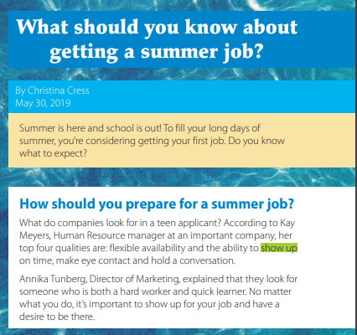
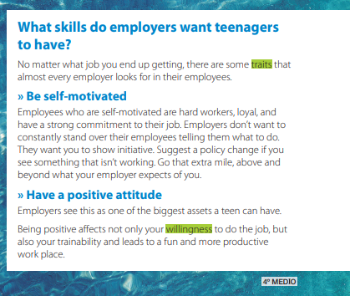
Read the following text

Slide 6
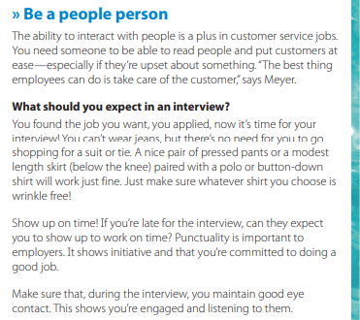
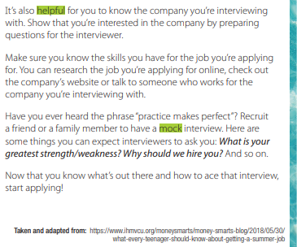
What was the text about?

Slide 7
Give your opinion
Da tu opinión
Give your opinion using “the steps of writing”
What do you think about working as a teenager in Chile?
Position: I think…
Reason: Because…
Example: For example…

